Slide 1

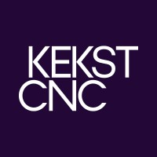
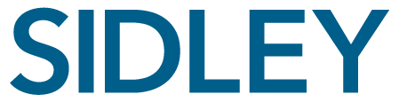
Simulating a Proxy Fight
September 19, 2025
A Presentation for the 21st Annual Boardroom Summit
Washington, D.C.

Slide 2
Table of Contents
I |  | Mock Activist Campaign |  | 3
II |  | Shareholder Activism Preparedness |  | 21
Appendix |  | Presenters |  | 23
Small-group discussion topic

Slide 3
Section I Mock Activist Campaign

Slide 4

Target: Deepwell Energy Inc.
MOCK ACTIVIST CAMPAIGN
Deepwell Energy Inc., an upstream oil and gas producer, has historically delivered stable earnings results, meeting overall street expectations and paying out a stable dividend
However, many of its closest peers have recently been acquired or completed acquisitions that make them significantly larger than Deepwell
Bob, the Company’s CEO, has a larger than life personality and has a significant social media following
On a 1- and 3-year total shareholder return basis, the Company has underperformed its peer group and key indices; it has also underperformed during Bob’s tenure as CEO, which is approaching 10 years
The Company has a classified board and average director tenure of more than 10 years

Slide 5
Target: Current Shareholder Base
MOCK ACTIVIST CAMPAIGN
Rank by Shares O/S%⁽¹⁾ | Shareholder | % of Shares O/S | # of Proxy Contests Voted⁽²⁾ | ISS Match⁽¹⁾ | Favorability towards Co.
1. | Vanguard Group | 8.9 | 35 | 60%
2. | BlackRock Fund Advisors | 5.8 | 38 | 71%
3. | Capital Research and Management | 4.4 | 12 | 75%
4. | Columbia Management | 3.9 | N/A | N/A
5. | Northern Trust Global Advisors | 3.6 | 71 | 74%
6. | Fidelity | 3.5 | 32 | 62%
7. | T. Rowe Price | 3.2 | 36 | 77%
8. | AllianceBernstein | 2.8 | 35 | 73%
9. | Wellington Management | 2.7 | 20 | 74%
10. | Norges Bank Investment Management | 1.5 | 23 | 46%
11. | Susquehanna Investment Group | 1.3 | N/A | N/A
12. | D.E. Shaw & Co. | 1.1 | 23 | 100%
13. | Nordea Investment Management | 0.8 | 1 | 100%
14. | Ivan Indiana (retired cofounder) | 0.8 | N/A | N/A
15. | Beta Management | 0.5 | 49 | 80%
xx. | Retail Shareholders | 44.7 | N/A | N/A | N/A
44.8% institutional ownership

Slide 6
Target: Board Overview
MOCK ACTIVIST CAMPAIGN
Director | Gender | Age | Tenure (years) | Other Current Public Co. Boards | Committee Membership
 |  |  |  |  | Audit | Compensation | Nominating and Governance
Andy Albany Chair of the Board | Male | 67 | 14 | N/A |  | ✔ | ✔
Bob Bluth† Chief Executive Officer | Male | 54 | 10 | N/A
Carl Comstock | Male | 76 | 14 | 2 Boards
David Dewey | Male | 68 | 6 | 1 Board | ✔ |  | Chair
Eddy Essex | Male | 67 | 4 | 2 Boards | Chair
Faisal Fitzgerald | Male | 62 | 0 | 4 Boards |  | Chair
Gil Gonzalez | Male | 70 | 5 | N/A |  | ✔ | ✔
Hannah Higgins | Female | 64 | 3 | 3 Boards | ✔ |  | ✔
Ivan Indiana Retired Cofounder | Male | 78 | 25 | N/A |  |  | ✔
Jack Jefferson | Male | 79 | 20 | 2 Boards
† Not Independent

Slide 7
Target: Board Structure and Practices
MOCK ACTIVIST CAMPAIGN
Category | Company Board (10 directors) | Risk Level⁽¹⁾
Tenure and Board Refreshment | Average director tenure is over 10 years 5 directors have a tenure of 10 or more years 2 directors, including a retired co-founder, have a tenure of 20 or more years 2 directors joined the Board within the past three years The Company does not have term limits for directors | ?
Age | 3 directors are over 75 years of age The average age of directors is high (68.5) The Company does not have an age-based retirement policy for directors | ?
Public Company Board Service | 6 directors currently sit on at least one other public company board 2 directors have never served on another public company board No directors are considered to be over-boarded under the voting policies of ISS or Glass Lewis, but one director serves on four boards total | ?
Board Structure and Leadership | Classified structure Board size of 10 directors is slightly higher than most peer companies’ boards | ?
Diversity | 1 director is female 1 director is racially/ethnically diverse | ?
Director Stock Ownership | The Company has stock ownership guidelines for directors; all but one of the directors are in compliance with the guidelines Pledging and hedging of Company stock are prohibited | ?
Director Independence | The Board has deemed that all directors other than the CEO are independent (including the Company’s founder) All committees are made up solely of independent directors | ?
Risk Level indicates the likelihood that the item could become a target of criticism in an activism campaign.

Slide 8

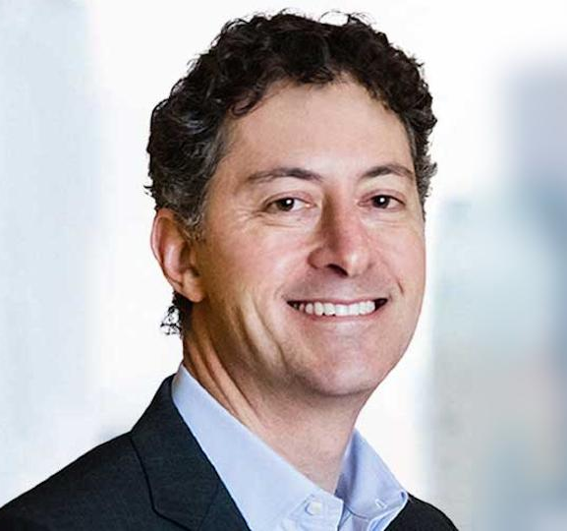
Phase 1: Initial Contact
MOCK ACTIVIST CAMPAIGN

Slide 9
Phase 1: Initial Contact
MOCK ACTIVIST CAMPAIGN
SCENARIO
Topics
Alpha Partners, an activist hedge fund run by Chad, has reached out to the Company’s Head of IR, requesting a meeting be set up with Bob, the Company’s CEO
Chad asked that the meeting take place in-person within the next week, noting in their email that they are a significant shareholder
An analyst from Alpha held an introductory call with the Company two weeks earlier; the analyst mentioned that they are a new shareholder but did not indicate any specific views at the time
The outreach email mentions that the Company is trading at a significant discount to its intrinsic value
Around the same time, the Company’s stock watch service flagged a spike in volume
The window for shareholders to nominate directors closes in eight weeks
Should the Company accept the meeting in-person? When? Who goes?
What team should be assembled to represent the Company?
What should the Company do to prepare for that meeting?

Slide 10

Phase 2: Management Engagement
MOCK ACTIVIST CAMPAIGN

Slide 11
Phase 2: Management Engagement
MOCK ACTIVIST CAMPAIGN
SCENARIO
Topics
At the meeting, Alpha presents its views on the Company:
Alpha is highly critical of Bob’s performance during his tenure
Chad says he is willing to work cooperatively if the Company begins a strategic alternatives review and Chad is appointed to the Board to oversee the process
After the meeting, Alpha sends a private letter to the Board summarizing its criticisms; the letter includes a threat about “taking this directly to the shareholders” if the Board fails to respond in a timely manner
The window for shareholders to nominate directors closes in four weeks
What are some legal considerations for the Board in reviewing Alpha’s proposals?
How should the Board prepare for the letter to potentially go public?

Slide 12
Phase 2: Typical Activist Demands
MOCK ACTIVIST CAMPAIGN
Activist platforms almost always include economic and governance demands
Economic |  | M&A |  | Sell the company Spin-off divisions, recently-acquired businesses or standalone assets Challenge pending M&A transactions Push for new M&A strategy
 |  | Balance Sheet |  | Increase capital return (e.g., increase share buyback, initiate dividend) Increase leverage
 |  | Operational |  | Pursue cost-cutting measures Pursue new business strategies Diversify customer base
Governance |  | Board |  | Change board leadership Refresh long-serving directors
 |  | Compensation |  | Reduce executive compensation Modify incentive structures
 |  | Other Governance |  | Shareholder rights/takeover defenses Review related party transactions

Slide 13
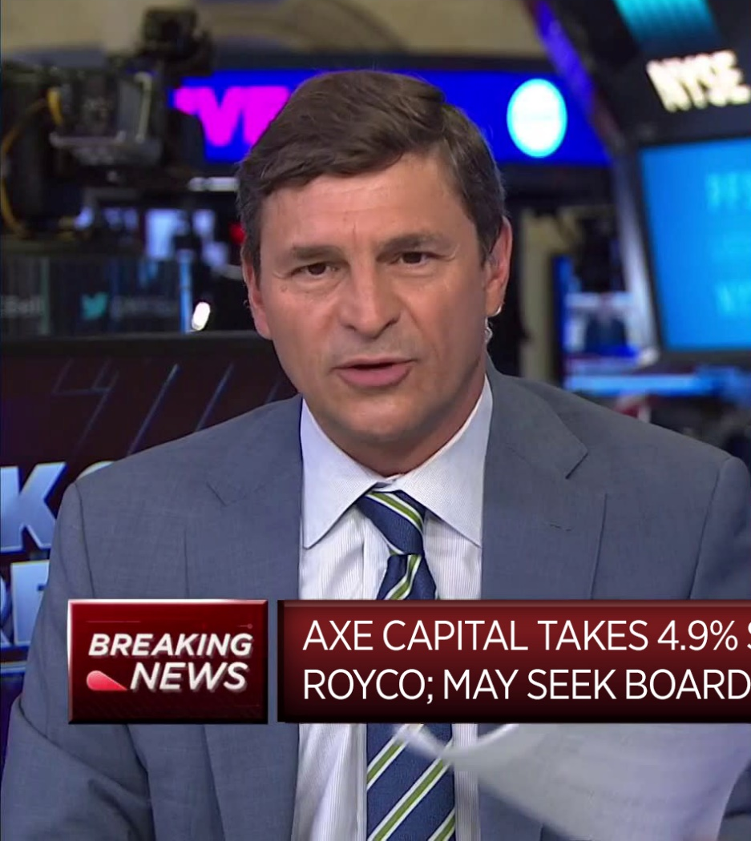

Phase 3: Going Public
MOCK ACTIVIST CAMPAIGN
ALPHA PARTNERS TAKES 2.9% STAKE IN DEEPWELL ENERGY; THREATENS CAMPAIGN

Slide 14
Phase 3: Going Public
MOCK ACTIVIST CAMPAIGN
SCENARIO
Topics
Two weeks prior to the nomination deadline, Alpha goes public
First, Alpha leaks its letter to the Board to The Wall Street Journal, which writes about it on a Sunday evening
Monday morning, Alpha publicly discloses its letter via press release and discloses a 2.9% stake, criticizing Deepwell’s performance and demanding the Board search for a new CEO and threatening to nominate directors
On the same day, Chad goes on CNBC, attacking the Company in an interview
The Company’s stock price increases 12%
Beta Management, a 0.5% shareholder, endorses Alpha’s campaign
Should the Company initiate outreach to its top shareholders at this time?
How should the Company respond to Alpha’s public campaign?

Slide 15

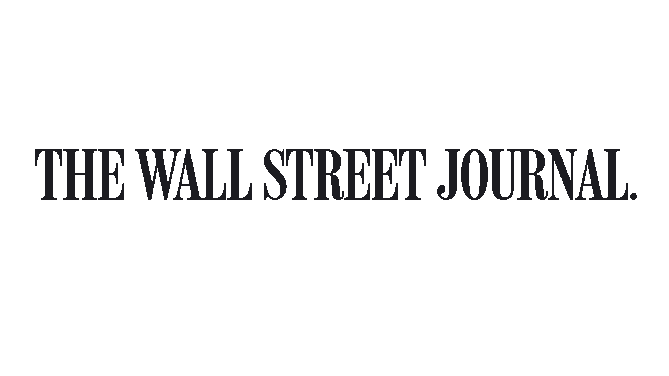
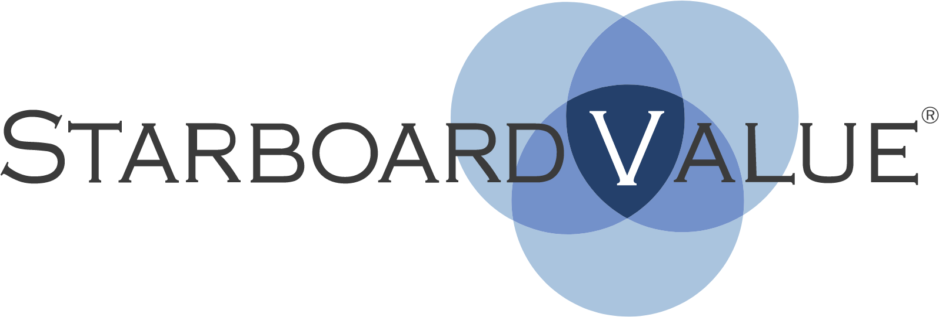

Phase 4: Director Nomination Notice
MOCK ACTIVIST CAMPAIGN
Activist Investor Alpha Partners to Launch Proxy Fight at Deepwell Energy
The activist hedge fund nominates three directors to the Company’s board of directors
By Lauren Smith
Re: Notice of Director Nominations for Election to the Board at the 2026 Annual Meeting of Deepwell Energy, Inc.
Dear Ms. General Counsel:
This letter serves as notice to Deepwell Energy, Inc., a Delaware corporation (the “Company”), as to the nomination by Alpha Partners (“Alpha”), of nominees for election to the board of directors (the “Board”) at the Company’s 2026 annual meeting of stockholders.

Slide 16
Phase 4: Director Nomination Notice
MOCK ACTIVIST CAMPAIGN
SCENARIO
Topics
One week before the nomination deadline, Alpha submits a nomination notice for three director candidates; one candidate is Alpha’s principal Chad and two other candidates are unaffiliated nominees with significant industry experience
Alpha issues a press release that discloses its nominations and campaign for change
Alpha also launches a fight website, www.MakeDeepwellGreatAgain.com, where it publishes its research and letters
Following Alpha’s press release, the Company’s stock price increases another 4%
Alpha’s attorneys also submit a demand for the Company’s shareholder list
How does the Company review the nomination notice?
Should the Company respond publicly to Alpha’s nominations?
Should the Company consider the adoption of a poison pill in light of Alpha’s stock accumulation?

Slide 17

Phase 5: Settlement
MOCK ACTIVIST CAMPAIGN
DRAFT
COOPERATION AGREEMENT
This Cooperation Agreement, dated as of [●] (this “Agreement”), is by and among Deepwell Energy, Inc., a Delaware corporation (the “Company”) and the persons and entities set forth on Schedule A hereto (collectively, and, for clarity and as applicable, each member thereof acting individually, the “Alpha Group”).
RECITALS
WHEREAS, the Company and Alpha Partner LP, a member of the Alpha Group, have engaged in various discussions and communications concerning the Company’s business, financial performance and strategic plans;

Slide 18
Phase 5: Settlement
MOCK ACTIVIST CAMPAIGN
SCENARIO
Topics
Two weeks after its director nominations, Alpha asks for a meeting with Bob and several directors to discuss the nominations
During the meeting, Alpha claims that it has spoken with many shareholders, all of whom support its director nominations
Alpha makes a settlement proposal in exchange for withdrawing its nominations:
the appointment of two new directors: one from its slate, including its principal Chad, and one mutually agreed with the Company;
the retirement of three incumbent directors;
a new shareholder value enhancement committee led by Chad to oversee a strategic review process and assess capital allocation
What are the costs of settling with Alpha?
How should the Board evaluate the settlement offer?

Slide 19


Phase 6: Proxy Fight
MOCK ACTIVIST CAMPAIGN

Slide 20
Phase 6: Proxy Fight
MOCK ACTIVIST CAMPAIGN
SCENARIO
Topics
Alpha and the Company file their respective proxy materials with six weeks to go to the annual meeting
Alpha issues press releases claiming that the Board has not held management accountable and points to what it characterizes as critical governance flaws that would be remedied by its nominees
Alpha’s outreach to the Company’s shareholders is intensifying and several other large shareholders, mostly actively managed funds, are supportive of Alpha
ISS and Glass Lewis schedule meetings with each of the parties to discuss the proxy contest ahead of issuing their recommendations
How can the Company best reach its retail shareholders? Does that differ from its strategy to target institutional investors?
The Board complains about inaccuracies in Alpha’s campaign—are there any legal options?
What is the importance of ISS and Glass Lewis in a proxy contest? What are the key factors for the proxy advisory firms?

Slide 21
Section II Shareholder Activism Preparedness

Slide 22
Activism Preparedness Checklist
SHAREHOLDER ACTIVISM PREPAREDNESS
# | Task | Description | Status
1 | Assemble Response Team | Assemble a response team during peacetime to be on standby in the event of an activist attack; engage non-legal advisors through outside counsel to protect and preserve privilege
2 | Prepare Communications Plan | Prepare a “break the glass” communications plan with “shelf” press releases and media statements; prepare CEO for unexpected call from an activist
3 | Increase Activist Surveillance | Retain stock watch service to monitor trading in the stock to receive an early warning in the event an activist builds a stake; monitor investor relations website for activist activity
4 | Conduct Financial Self-Evaluation | With the assistance of a financial adviser and consultants, evaluate the strategy, capital allocation and performance of the company like an activist
5 | Review Legal Defenses | Review the company’s charter and bylaws to assess legal strengths and weaknesses (including to address the universal proxy rules)
6 | Review Corporate Governance | Analyze the company’s corporate governance from a proxy campaign standpoint (board composition and practices, compensation, shareholder rights, related party transactions, ESG, etc.), as benchmarked against peers
7 | Prepare Shelf Poison Pill | Prepare an up-to-date, fully drafted and negotiated “shelf” poison pill to enable the board to react quickly in the event an activist rapidly accumulates a large stake
8 | Develop Investor Relations Plan | Have regular one-on-one meetings with your major investors (including index funds); screen meeting requests for activists and hostile bidder; conduct perception surveys; use NOBO list for retail shareholder segmentation
9 | Analyze D&O Insurance Coverage | Analyze the company’s D&O insurance policies and explore coverage for an activism campaign
10 | Conduct Tabletop Exercise | Have a “mock campaign” session with senior management as well as with the board to educate them on how an activist campaign unfolds
22

Slide 23
Appendix Presenters

Slide 24
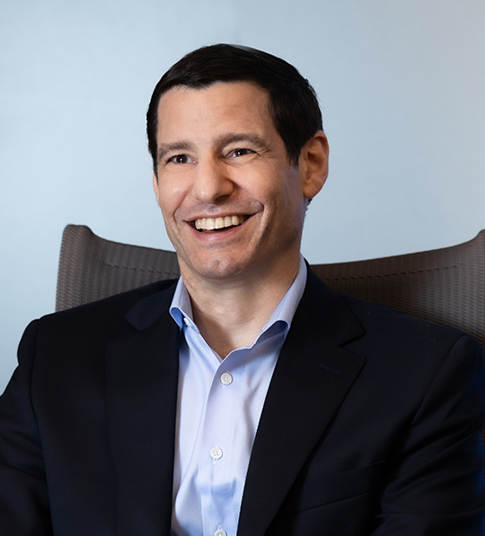
Jeremy Fielding Co-Chief Executive Officer, Partner, Co-Chair of Contested Situation Practice
PRESENTERS
Jeremy provides strategic guidance and communications counsel to boards of directors and management teams of international and U.S. public companies and private institutions across industries. For over 25 years, he has advised clients on their most pressing and high-profile communications initiatives, including strategic challenges and opportunities.
His client engagements span a wide range of special situations, contested situations, shareholder activism and corporate governance matters, as well as ongoing strategic positioning and investor relations activities. Jeremy also has significant experience advising clients on crisis communications; M&A; Litigation and regulatory support; and Bankruptcy & Restructurings, among other matters.
In addition to his experience at Kekst CNC, Jeremy spent a year (2009-2010) as partner at Finsbury Group. He is the Former President of Central Synagogue and serves on the Board of Directors of Lawyers for Children and the American Friends of Ditchley.
Jeremy holds a B.A. in International History and Politics, with Honors, from the University of Leeds, an M.S. in Foreign Service from Georgetown University, and a Ph.D. in History from Yale University.
PARTNER New York
+1 212 521 4858 (o)
+1 646 644 4825 (c)
jeremy.fielding@kekstcnc.com
SELECT CONTESTED SITUATIONS EXPERIENCE
Nestle
Cano Health
CenterPointEnergy
Starbucks
PPG
FirstEnergy
DuPont
Intuit
JetBlue
Citrix
ODP
Adani Group
Medical Properties Trust
GM
TPIL
Chiquita
Vusion
Adani Group
MKS
Public Storage
Ingersoll Rand
Merck KGaA
Arcelor
Ambac
Cadbury
Televisa
Wendy’s
Nielsen
Charles River Laboratories
UNFI
OmniLogistics
IronSource

Slide 25
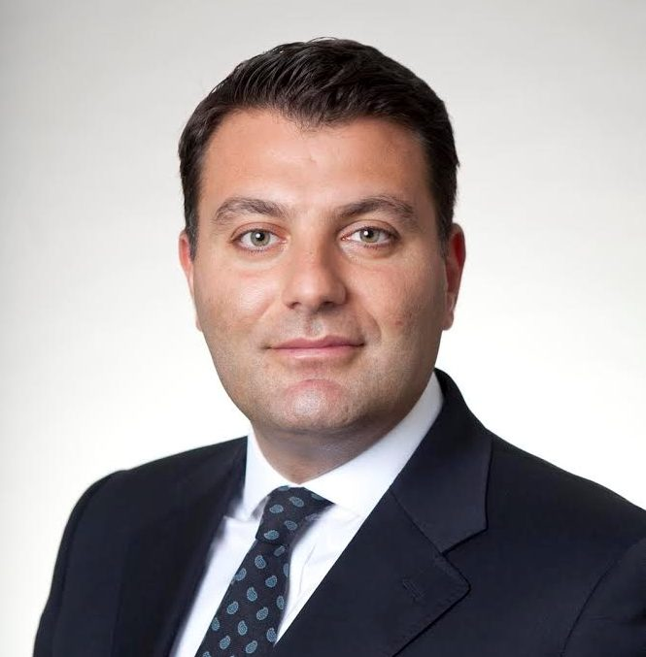
Alfredo Porretti Managing Director, Global Co-Head of Shareholder Engagement and M&A Capital Markets
PRESENTERS
Alfredo is Global Co-Head of J.P. Morgan’s Shareholder Engagement and M&A Capital Markets (“SEAMAC”) team. Prior to joining J.P. Morgan, Alfredo was a Managing Director and Head of Greenhill’s Shareholder Advisory Group and a senior member of Morgan Stanley’s Shareholder Activism and Corporate Defense Team. During his tenure, Morgan Stanley became the leading shareholder advisory team on Wall Street.
Alfredo started his career in investment banking in Lazard’s Financial Institutions Group and Activism Defense Group in New York. He previously was an M&A lawyer at Simpson Thacher & Bartlett in New York, focusing both on private equity and strategic transactions. Alfredo regularly speaks at conferences and leading industry events on the topic of shareholder engagement, activism, ESG and corporate defense.
Alfredo graduated from Harvard Law School (LLM), the College of Europe in Bruges–Belgium (LLM) and from the University of Milan–Italy (JD).
MANAGING DIRECTOR New York
+1 212 622 6175 (o)
+1 646 320 9835 (c)
alfredo.porretti@jpmchase.com
SELECT EXPERIENCE
Performance Food Group in its proxy contest defense against Sachem Head
BlackRock in its defense against Saba Capital Management
Rapid7 in its defense against JANA Partners
Veradigm in its defense against Kent Lake
Healthcare Realty Trust in its defense against Starboard Value
Matthews International in its defense against Barington
Cheesecake Factory in its defense against JCP Investment Mgmt.
MarineMax in its defense against Island Capital and Levin Capital
Encore Wire in its defense against Avenue Investment Mgmt.
BioMarin in its defense against Elliott
Omni in its defense against Ancora
MRC Global in its defense against Engine Capital
ContextLogic in its defense against Cannell Capital
IHS in its defense against Blackwells, MTN and Wendel
Yelp in its defense against TCS
Cano Health in its defense against Barry Sternlicht, Third Point
LL Flooring in its defense against Live Ventures / F9
HF Foods Group in its defense against Irrevocable Trust
Japan Investment Corp in its engagement with JSR / ValueAct
Semtech in its defense against Lion Point
Bath & Body Works in its defense against Third Point
IAA in its defense against Ancora
Pitney Bowes in its defense against Hestia Capital
Wix in its defense against Starboard Value
Radius Health in its defense against Velan Capital / Repertoire
Twitter in its defense against Elon Musk
Hasbro in its defense against Alta Fox
Lee Enterprises in its defense against Alden Global Capital
U.S. Foods in its defense against Sachem Head
Healthcare Trust of America in its defense against Elliott
IFF in its defense against Sachem Head

Slide 26
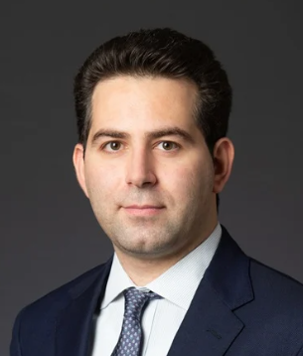
Reuben Zaramian Partner, Shareholder Activism & Corporate Defense Practice
PRESENTERS
Reuben Zaramian counsels public company boards and management teams through high stakes investor engagement and activism defense matters. Over the past decade, he has represented clients in hundreds of mandates, including many of the most notable late-stage proxy fights and settlements.
Reuben advises on all aspects of shareholder activism, drawing on his extensive experience with governance strategy and corporate preparedness, special situations, risk management, fiduciary duties and environmental, social and governance (ESG) issues. He also advises on Section 13 and 16 issues.
Since joining Sidley’s Activism & Corporate Defense Practice in 2018, the group has risen to the top of every shareholder activism defense league table and is ranked in Band 1 for “Takeover Defense” by Chambers USA. Reuben was named to the Legal 500 as a key lawyer for M&A/Corporate and Commercial Shareholder Activism: Advice to Boards (2025) and recognized by Best Lawyers: Ones to Watch for Corporate Governance (2026).
Earlier in his career, Reuben represented many of the leading hedge funds at a New York law firm with a prominent shareholder activism practice—he now leverages that experience for company-side clients. He speaks and publishes frequently on matters related to shareholder activism and corporate governance.
PARTNER New York
+1 212 839 5921 (o)
+1 917 797 4278 (c)
rzaramian@sidley.com
SELECT EXPERIENCE
BlackRock in its proxy contest defense against Saba Capital
Bausch Health in its engagement with Carl Icahn
CAE in its engagement with Browning West
Quanterix in its proxy contest defense against Kent Lake
Veradigm in its engagement with Kent Lake
National Vision in its engagement with Engine Capital
nCino in its engagement with HMI
Overstock/Beyond in its engagement with JAT Capital
Texas Pacific Land Corporation in its proxy contest defense against Horizon Kinetics and SoftVest
Rogers in its proxy contest defense against Starboard Value
Purple Innovation in its takeover defense against Coliseum Capital
US Foods in its proxy contest defense against Sachem Head
Avantax/Blucora in its proxy contest defense against Ancora Advisors and Engine Capital
Milestone Pharmaceuticals in its engagement with Alta Fundamental
AT&T in its activism campaign defense against Elliott
Cubic in defense of an unsolicited takeover bid by Elliott and Veritas
NiSource in its activism campaign defense against Elliott
CVS in connection with a reported activism investment by Starboard
Alkermes in its proxy contest defense against Sarissa Capital and Elliott
Herbalife with respect to various investor engagements
Big Lots in its proxy contest defense against Macellum Capital and Ancora
Delek in defense of an unsolicited takeover bid by Carl Icahn and CVR
MiMedx in its proxy contest defense against Prescience Point & Parker Petit
AMG funds in their proxy contest defense against Friess Associates
Invesco funds in their engagement with Saba Capital
Royce funds in their proxy contest defense against Saba Capital
UBS funds in their proxy contest defense against Ocean Capital
Trian Partners in its proxy contest against Procter & Gamble (prior to Sidley)

